Slide 1
Chapter 13
Monopolistic Competition: The Competitive Model in a More Realistic Setting
Notes:
Welcome to Economics!
Does this work?

Slide 2
Monopolistic competition A market structure in which:
many firms compete by selling similar, but not identical, products
barriers to entry are low
Compare this structure to perfect competition:
What are the implications of selling a differentiated product?

Slide 3

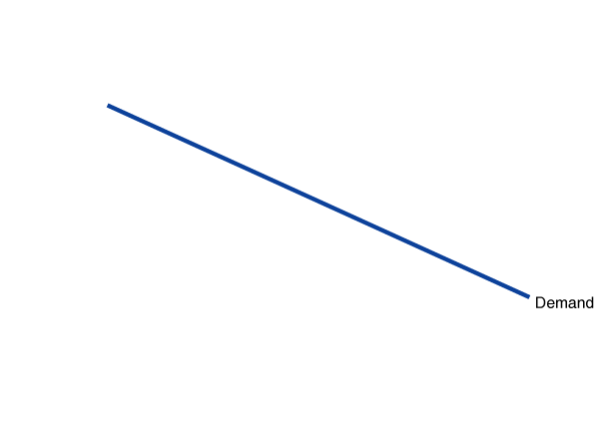
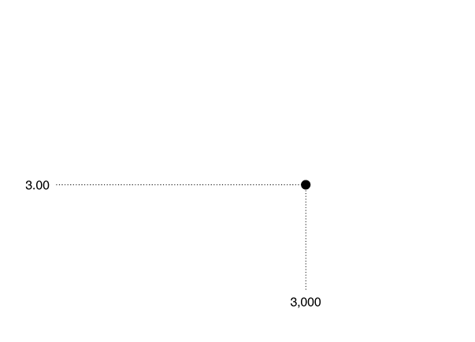
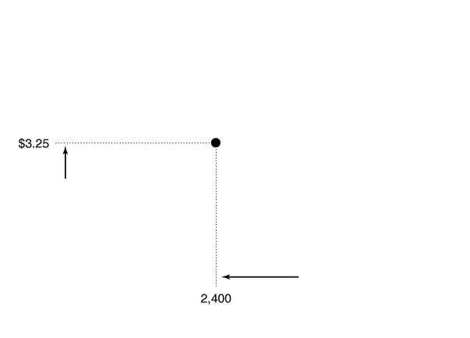
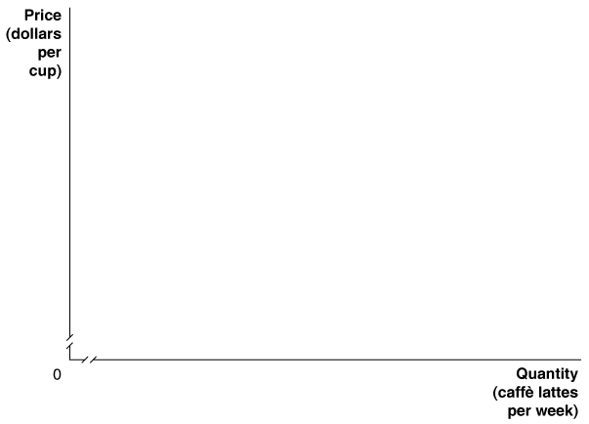
The Demand Curve for a Monopolistically Competitive Firm
The Downward-Sloping Demand for Caffè Lattes at a Starbucks

Slide 4
Marginal Revenue for a Firm with a Downward-Sloping Demand Curve
Demand and Marginal Revenue at a Starbucks
CAFFÈ LATTES SOLD PER WEEK (Q) |  | PRICE (P) | TOTAL REVENUE (TR = P x Q) | AVERAGE REVENUE (AR = TR/Q) | MARGINAL REVENUE (MR = ΔTR/ΔQ)
0 1 2 3 4 5 6 7 8 9 10 | $6.00 5.50 5.00 4.50 4.00 3.50 3.00 2.50 2.00 1.50 1.00 |  | $0.00 5.50 10.00 13.50 16.00 17.50 18.00 17.50 16.00 13.50 10.00 | ― $5.50 5.00 4.50 4.00 3.50 3.00 2.50 2.00 1.50 1.00 | ― $5.50 4.50 3.50 2.50 1.50 0.50 –0.50 –1.50 –2.50 –3.50

Slide 5
Why is MR less than Price for a Monop. Comp. firm?
What does the firm have to do to sell a greater quantity of output?
Suppose that the price is $5.50. Starbucks sells one latte and has total revenue of $5.50.
If it wants to sell two lattes, it must choose a lower price of $5. In terms of total revenue, this change has two effects:
Output Effect (an additional latte is sold)
Price Effect ($0.50 less is received for each latte that could’ve been sold at the higher price)

Slide 6
Price per Latte
Demand
Q of Lattes per week

Slide 7
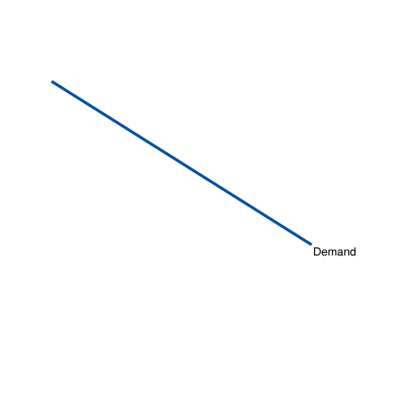
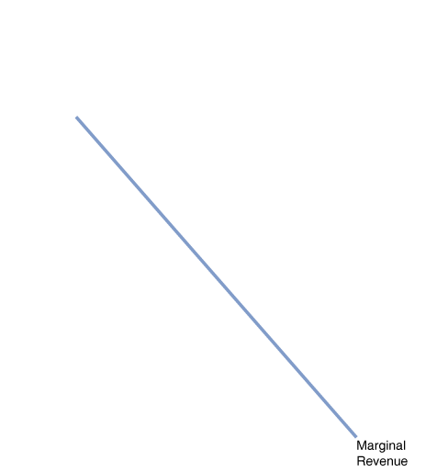
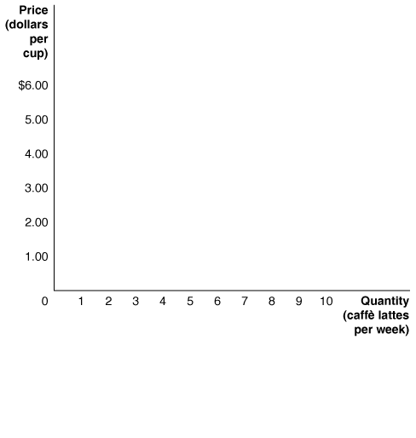
Marginal Revenue for a Firm with a Downward-Sloping Demand Curve
The Demand and Marginal Revenue Curves for a Monopolistically Competitive Firm
Every firm that has the ability to affect the price of its product (i.e. every firm with “market power”), has a marginal revenue curve that lies below its demand curve.

Slide 8
Short-run Profit Maximization in Monopolisitic Competition
Price
MC
Demand
MR
Quantity

Slide 9
Short-run Profit Maximization in Monopolisitic Competition
Price
MC
ATC
Demand
MR
Quantity

Slide 10
Short-run Profit Maximization in Monopolisitic Competition
Price
MC
ATC
Demand
MR
Quantity

Slide 11
Short-run Profit Maximization in Monopolisitic Competition
Price
MC
ATC
Demand
MR
Quantity

Slide 12
Long-run Equilibrium in Monopolistic Competition
Similar to Perfect Competition, there will long-run entry/exit of firms when there are short-run profits/losses.
If existing firms are earning economic profits, then new firms will _________ the industry. How do this affect the existing firms?
If existing firms are suffering losses, then some of these firms will _________ the industry. How do this affect the remaining firms?

Slide 13

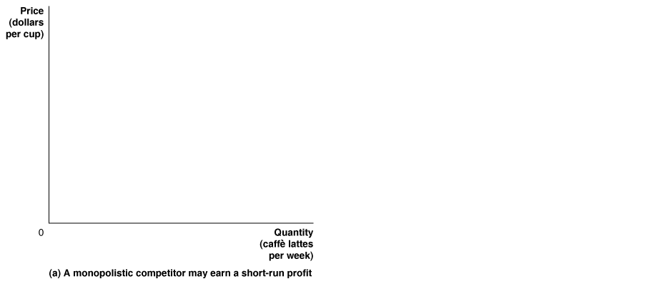
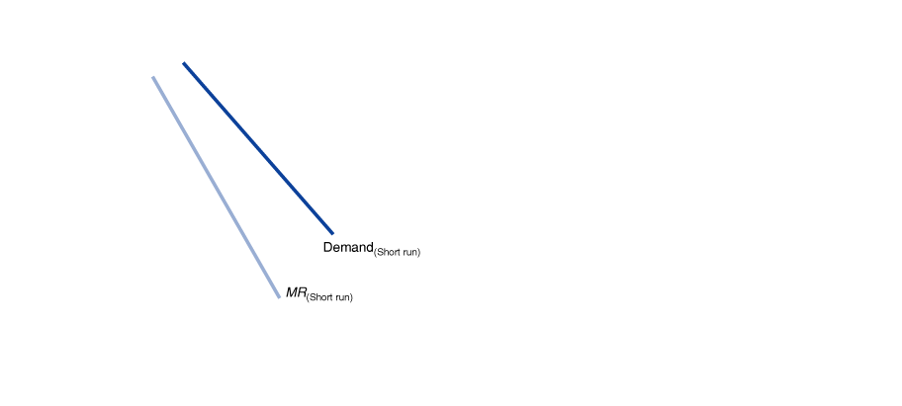
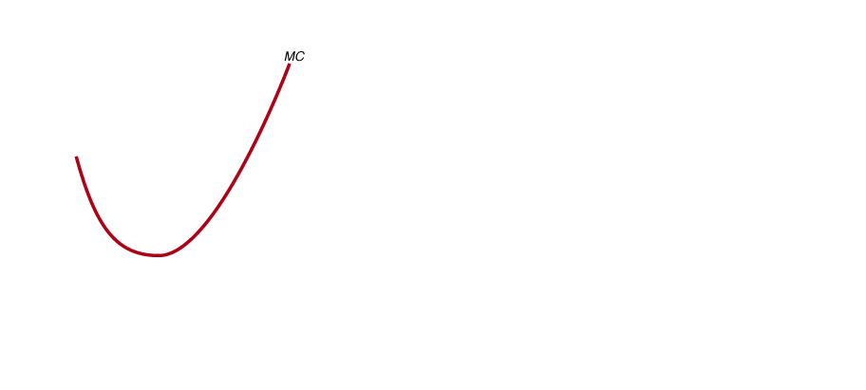

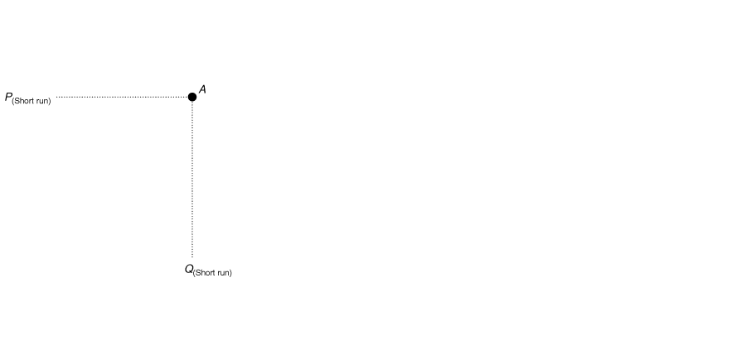

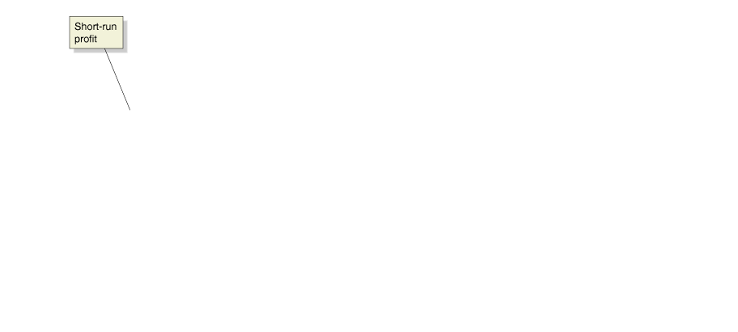
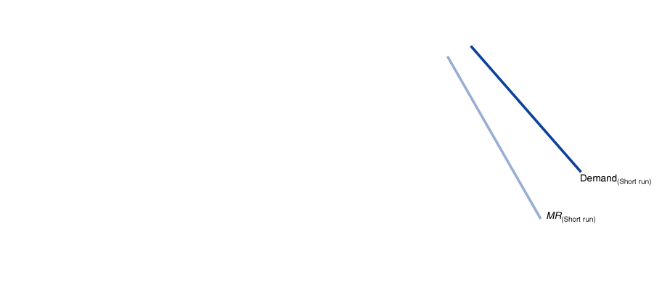
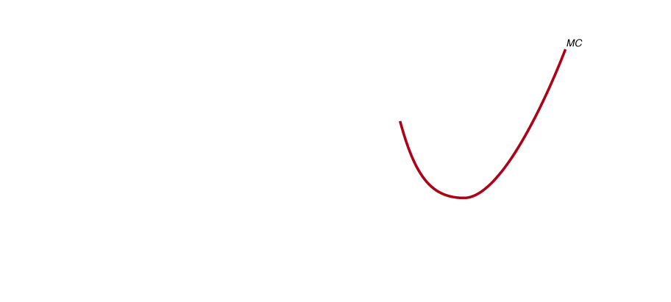
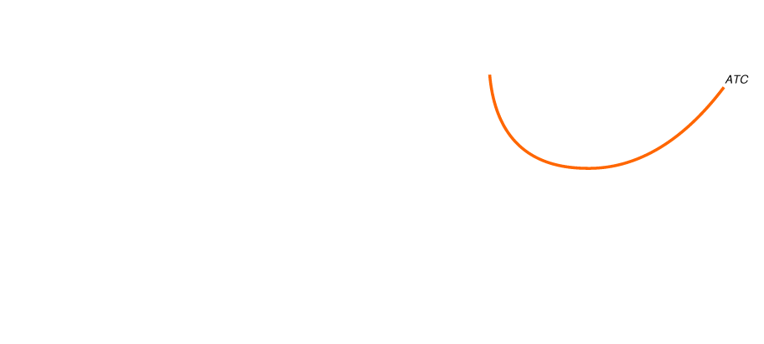
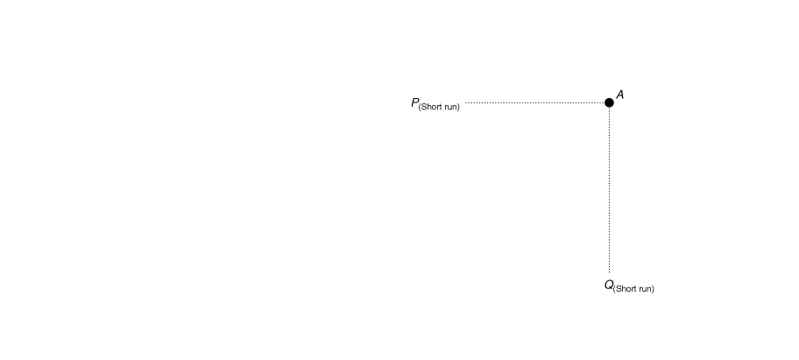
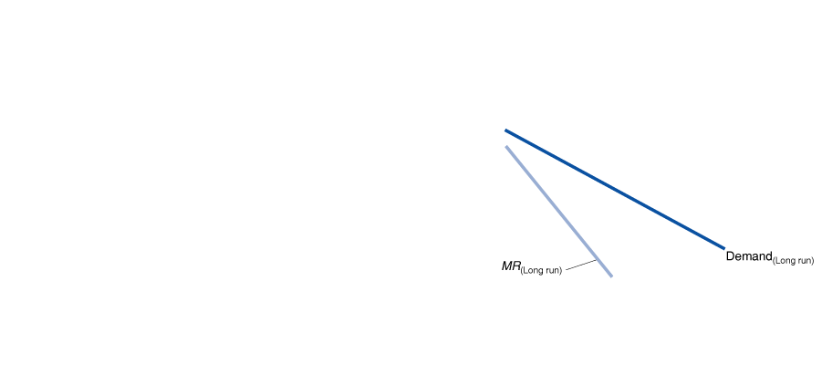
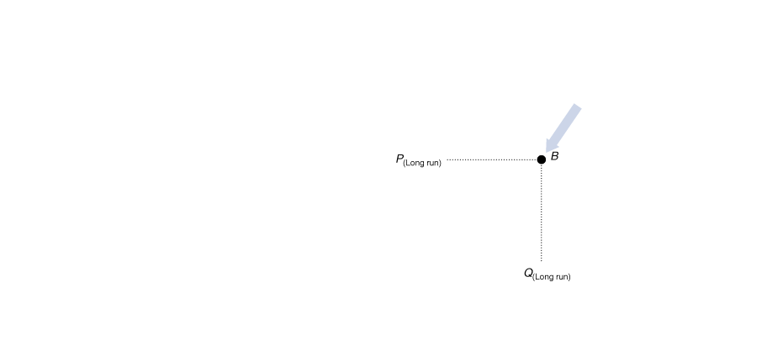
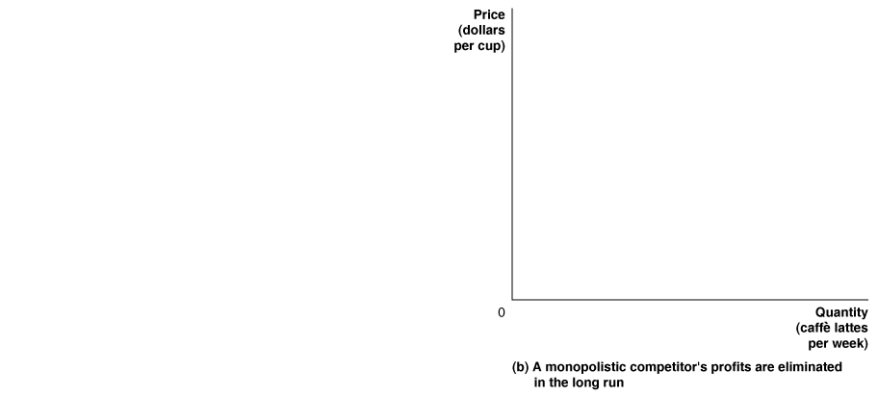
What Happens to Profits in the Long Run?
How Does the Entry of New Firms Affect the Profits of Existing Firms?
FIGURE 12-5
How Entry of New Firms Eliminates Profits

Slide 14
Long-run Equilibrium in Monopolistic Competition
Summary of adjustment from short-run situations to long-run equilibrium.
Existing firms are earning economic profits: implies entry of new firms which _________ demand for existing firms’ products. Thus, existing firms produce a ________ quantity at a __________ price. This process continues until:
Existing firms are suffering losses: implies exit of some firms which _________ demand for existing firms’ products. Thus, remaining firms produce a ________ quantity at a __________ price. This process continues until:

Slide 15
Is there any way for monopolistically competitive firms to earn economic profits in the long run?

Slide 16
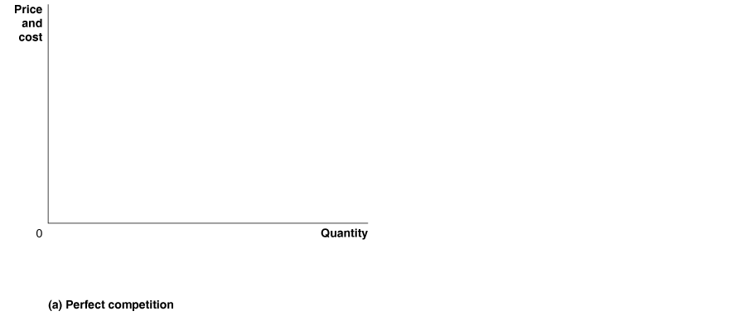
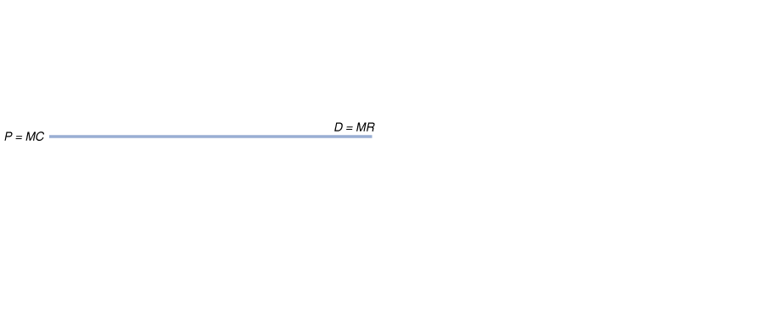
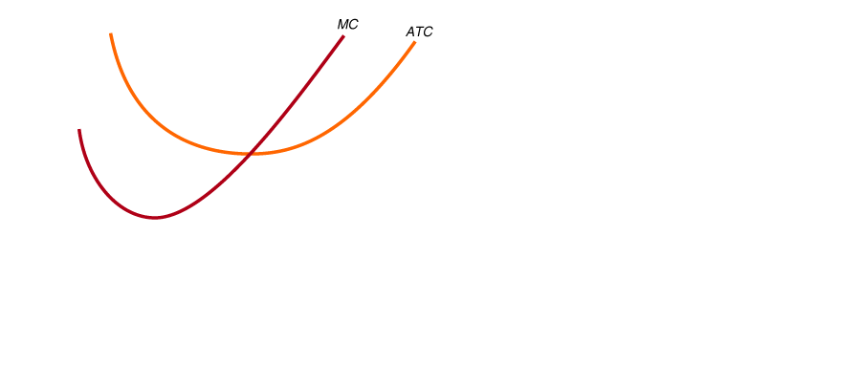
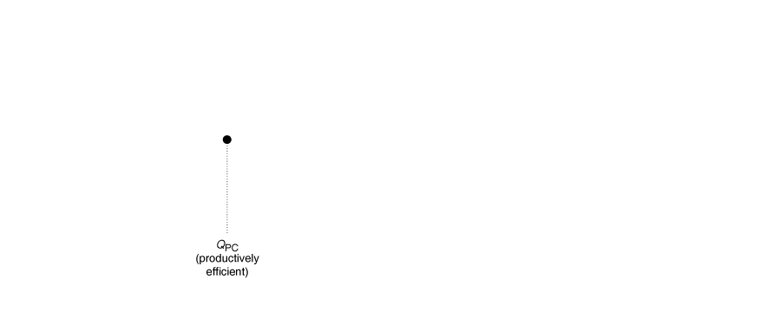
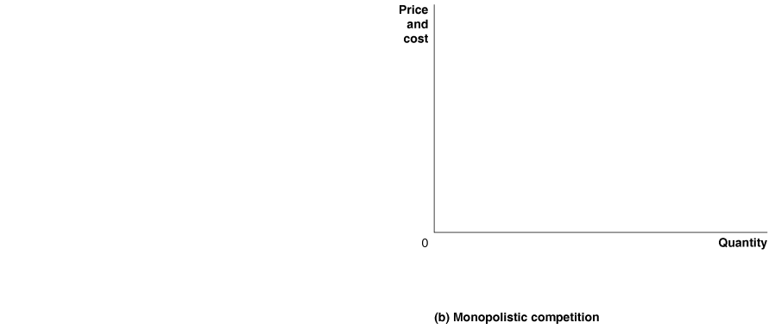
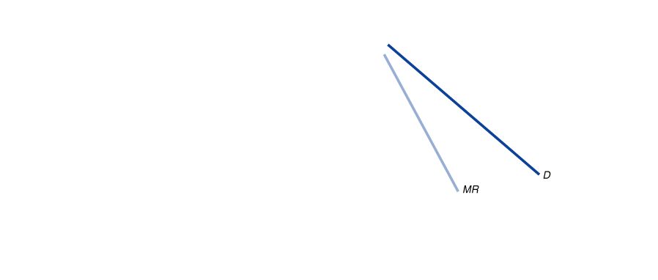
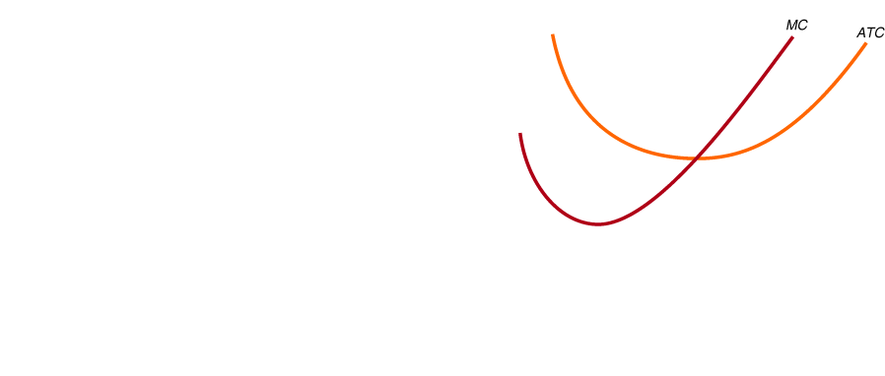
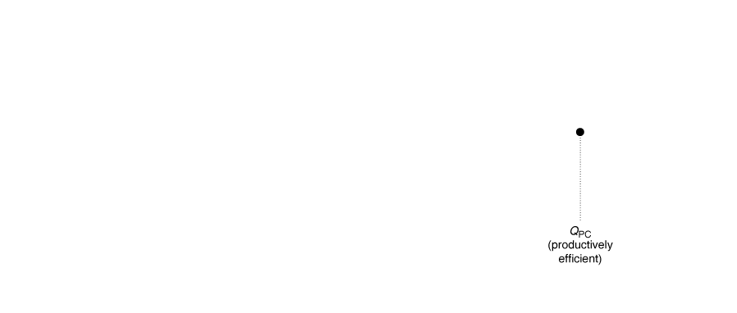
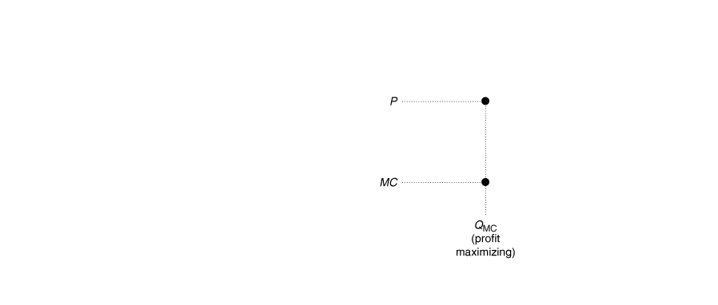
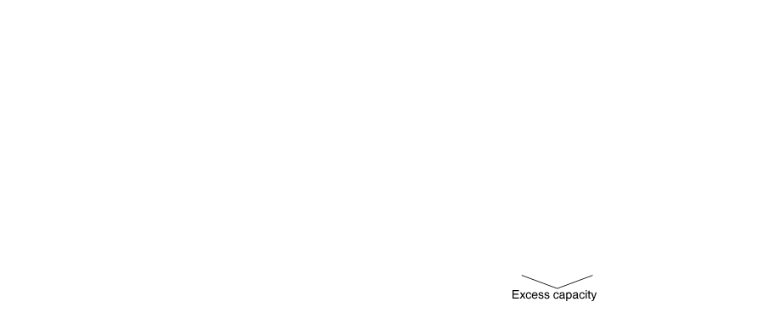
Comparing Perfect Competition and Monopolistic Competition
Comparing Long-Run Equilibrium under Perfect Competition and Monopolistic Competition
A monopolistically competitive firm has excess capacity: If it increased its output, it could produce at a lower average cost.

Slide 17
Monopolistic Competition and Economic Efficiency
Productive Efficiency: “least cost production”
Criteria: Does production occur at the lowest possible average total cost?
Allocative Efficiency: “net benefits to society are maximized”
Criteria: Do firms charge a price equal to marginal cost?
Despite these inefficiencies of monopolistic competition, consumers benefit from being able to purchase a product that is differentiated and more closely suited to their tastes.

